Slide 1


MINI PROJECT - II
PROJECT TITLE: GRAPHIC DESIGN PORTFOLIO
NAME:PRAVEEN N
ROLL NO:727621MCA061
GUIDE NAME:MRS.G.DEEPA M.E.,

Slide 2
ABSTRACT
This project based on web page is a sort of "Graphic Design Portfolio". A graphic design portfolio is a well curated presentation of work to the world. This web page contains some common features that can be found in some popular portfolio sites , which are the show my works, freelance work, course, etc. User can buy my products and sale , and learning graphic design courses. Admin can post their works in that page, sale of our products and manage activity.

Slide 3
EXISTING SYSTEM
In all work done manually, the processing of all the users details of who has saw the task, who all registered was not an easy to perform manually.
DRAWBACKS OF EXISTING SYSTEM
•Registrations are sometimes blocked,
•Security issues,
•Photos sometimes blocked.

Slide 4
PROPOSED SYSTEM
This reduces the workload of the user and it is also a easy to buy products in one website.Graphic design portfolio management is typically carried out by portfolio managers.The key focus of GDP is to make sure that all the outcomes in the portfolio support the strategic goals and business objectives of the organization.The system maintains all records easy. The proposed system consists of different packages in terms of cost range for each category of activity.

Slide 5
Benefits of the proposed system
•Gain Visibility,
•Productivity,
•Greater efficiency,
•Better service,
User and friendliness interactive

Slide 6
SYSTEM SPECIFICATION
HARDWARE REQUIREMENTS
•Processor : Intel i3 or any equivalent processor
•Memory : 4GB RAM
•Processor speed : 2.00 GHz
Hard Disk : 40GB

Slide 7
SOFTWARE REQUIREMENTS
•Operating System : Windows 7/8/10
•Front End : PYTHON
•Database : My SQL
•Web Server : XAMPP 10.4.21
•Designing : HTML, CSS
Validation : JavaScript

Slide 8
DATAFLOW DIAGRAM
LEVEL - 0
Sale Products
Admin
Dashboard
User
View
Add
Buy

Slide 9
LEVEL - 1
Product and Category
Update Products
User
Customer Detail
GRAPHIC DESIGN
PORTFOLIO
Customer Detail
Admin
Order Invoice
Confirm order

Slide 10
SYSTEM FLOW DIAGRAM
GRAPHIC DESIGN PORTFOLIO
ADMIN
USER
LOGIN
REGISTER
manage activities
price list
view producs
buy products

Slide 11
ER DIAGRAM
name
emailid
dob
ph.no
price
name
id
USER
purchase
PRODUCT
gets
cart
maintains
customer id
id
INVOICE
ADMIN
cart id
order details
name

Slide 12
USECASE DIAGRAM
GRAPHIC DESIGN PORTFOLIO
Login
View Products
Buy Products
Manage Products
Logout
USER
ADMIN

Slide 13
DATABASE DESIGN
ADMIN
Table Name : Admin
Primary key: Email-Id
Description : This table is store the user login details.
S.No | Field Name | Field Type | Size | Constraints | Description
1. | id | varchar | 40 | Primary Key | Admin id
2. | Password | varchar | 24 | Not null | Password

Slide 14
DATABASE DESIGN
USER
Table Name : User
Primary key: Email-Id
Description : This table is store the user details.
S.No | Field Name | Field Type | Size | Constraints | Description
1. | email_id | varchar | 40 | Primary Key | user email
2. | m_num | varchar | 15 | Not null | user mobile number

Slide 15
MODULE DESCRIPTION
ADMIN
•Manage User.
USER
•View Image Stocks,
•Contact Us,
•Buy the products.

Slide 16
ADMIN:
MANAGE USER
User management describes the ability for administrators to manage user access to various IT resources like systems, devices, applications, storage systems, networks, and more.User management enables admins to control user access and on-board and off-board users to and from IT resources.

Slide 17
USER:
A user is a person who utilizes a computer or network service.User can buy my designs using portfolio website. User can update their contact information for information processing. It’s providing them with information on how they can get in touch with you.
CONTACT US
The contact us link should lead to complete contact details and communication options.

Slide 18

User Interface Design
HOME PAGE

Slide 19

ABOUT

Slide 20
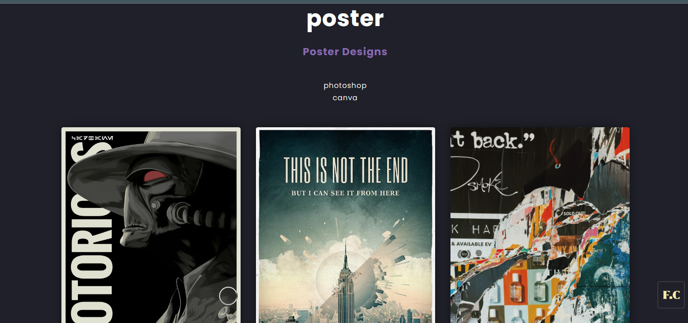
SERVICES
POSTER DESIGN

Slide 21
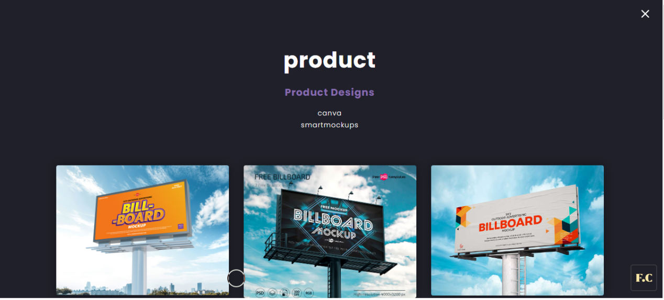
PRODUCT DESIGN

Slide 22
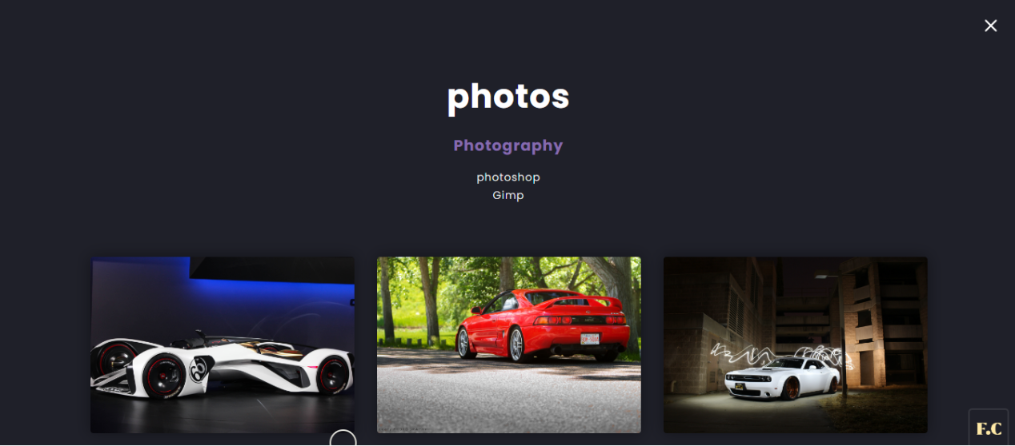
PHOTOGRAPHY

Slide 23
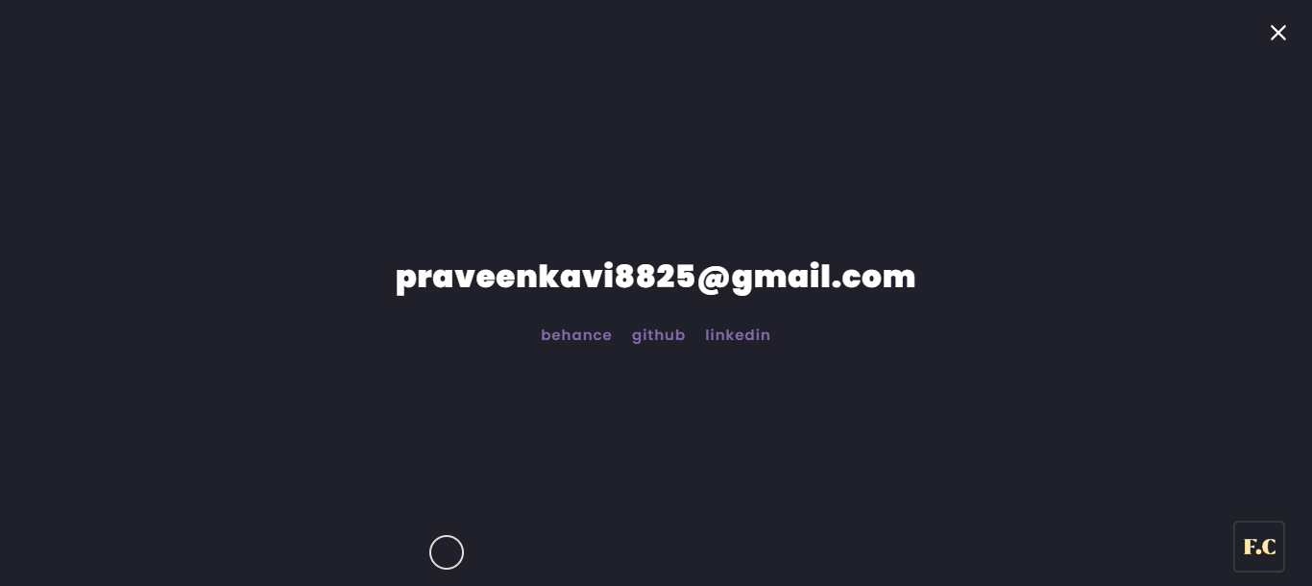
CONTACT PAGE

Slide 24
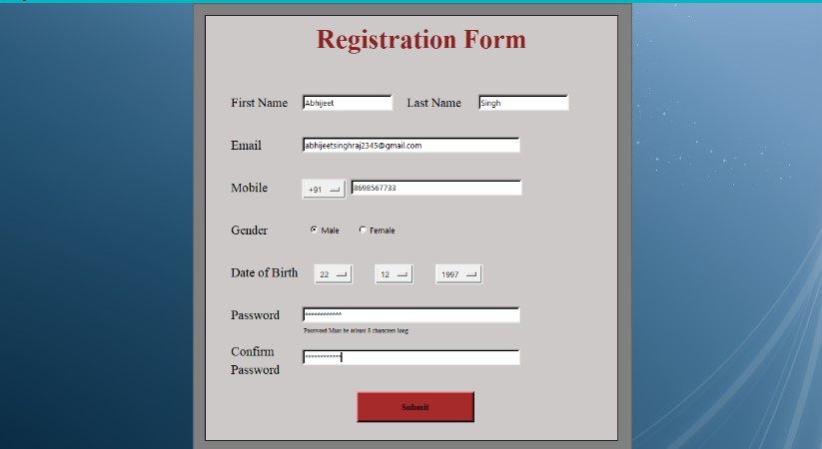
REGISTRATION

Slide 25
TEST CASE
TESTCASE ID | TEST CASENAME | TEST CASEDESC | TEST PRIORITY |  | RESULT
 |  |  | STEP | RESULT
1 | Username | To verify theuser name if it is unique | Nothing enters and focus on next control | An error message shows username is required | Fail
2 | Password | To verify thepassword if it is unique | When username & password is correct. | Accepted | Pass
3 | Valid Contact & email | for adding valid contact & email | valid mobile number and email | Uploaded Successfully | Pass

Slide 26
TESTING STRATEGIES
Functional Testing
This feature is tested by providing a valid and invalid mobile number and also by providing a valid and invalid combination of country code with the mobile number. For instance, an invalid country code with a valid mobile number or vise Versa. We ensure that correct error messages are provided in all the negative scenarios of the registration feature. Some other negative scenario is to verify the correct error message is displayed when the user enters less than or more than the required digits in the mobile number field.

Slide 27
Unit Testing
In Unit testing, test each module individually and integrate the overall system. Unit testing focuses verification effort even in the smallest unit of software development in each module. This is also known as module testing. The modules of the system is tested separately. Testing includes the process of checking Email Id and password, validating that the associate can move to respective module” sub modules. And also checking that this system is adaptable for all browsers. The modules events, coaches, rules and regulation Details, in forms and tested individually.

Slide 28
Validation Testing
Validation testing refers to a different set of activities that ensure that the system that has been traceable to customer requirements. Data entered by the user should be validated properly and finally moved to the server. Validation testing has been applied from the login page. Phone number can be validated.
•The username and Password is wrong the system should alert to the user that
“Enter the Valid Credentials”. Passwords are also validated.
• Based on the category the sub category should be loaded.

Slide 29
CONCLUSION
To conclude, “Graphic Design Portfolio” is a simple web based application basically suitable stack holder. It has very basic items which are used for the better usage of their user. It is very successful in making this application were we can view user and view and register activity in that web page.
This entire application is documented and can be easily understood by the users. The forms are very user friendly and also easy to handle even by the beginners with very little effort and guidance.

Slide 30
THANK YOU!

